Slide 1
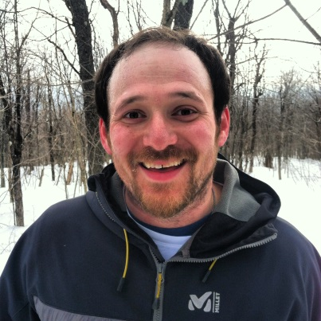
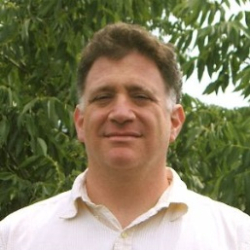
Dynamic Modeling of Forest Ecosystem Processes and Services in North American Boreal Forests within the ABoVE Study Region
PI: David Lutz, Dartmouth College
Co-PI: Manuel Lerdau, University of Virginia
Co-PI: Michael Palace, University of New Hampshire
Co-I: Xi Yang, University of Virginia
Co-I: Hank Shugart, University of Virginia
Collaborator: Adrianna Foster, Northern Arizona University
Dave Lutz Manuel Lerdau
(We’re both here this week)

Slide 2
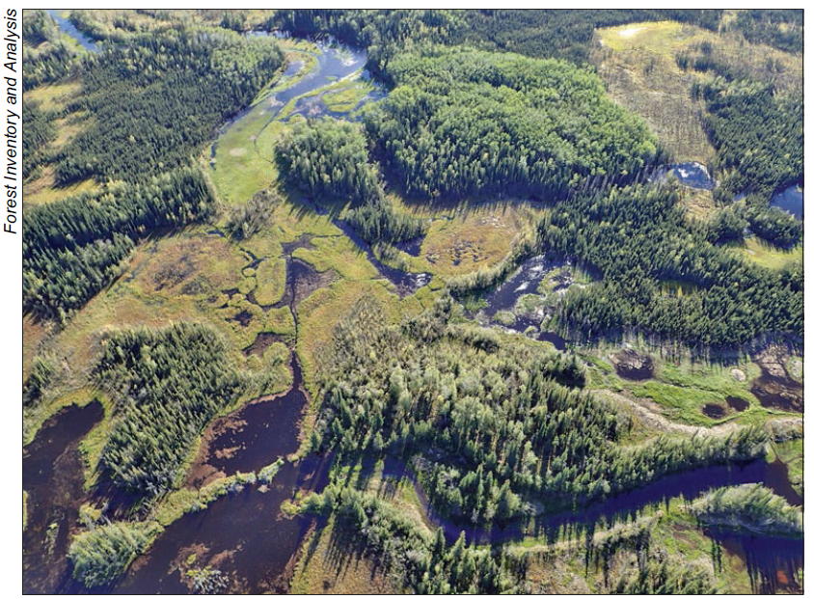
Our Project Rationale
1.) Boreal forests endure a climate with strong seasonal variability.
As a result, boreal stands are very malleable to changes in environmental conditions and are susceptible to wildfire. Specifically, because they often are found in low-diversity stands, they are also uniquely vulnerable to pest outbreaks.
2.) Boreal forest management varies considerably.
In North America, boreal forests cover a vast expanse and ownership adds to management variability. Adaptive management is difficult due to this variation as well as uncertainty about future climate conditions.
3.) Public Lands can be used as Case Studies.
Public lands are good locations for modeling scenarios because management is often legally required to follow decision-making rules. This provides modelers with defined prescriptions.
Photo from: Pattison et al. PNW-GTR-967
The Tanana Valley State Forest is managed for a variety of interests.

Slide 3
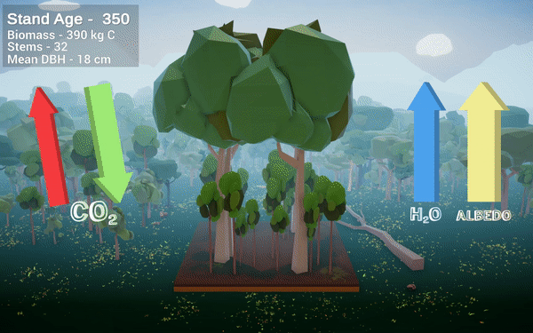
Our Project’s Main Objectives
(Adriana Foster)
1.) Simulate the dynamics of forest patterns and processes under future climate and disturbance scenarios using an individual-based forest gap model.
The gap model, UVA-FME, has been updated to simulate areas within the TVSF in a Phase 1 project by our collaborator Adrianna Foster (NAU). We will further calibrate the model by connecting it to remotely sensed imagery taken by other ABoVE scientists.

Slide 4
Our Project’s Main Objectives
2.) Assess tradeoffs in the delivery of ecosystem services under a set of stakeholder-informed management strategies at each study site using coupled forest-gap and ecological economics model output.
Essentially, we plan to work with stakeholders at our two study sites to elicit a set of management scenarios that we can use as inputs for the model. Once we construct simulations, we will provide these results to all stakeholders to think about what scenarios provided the sets of benefits that best fit the needs of the community.

Slide 5
Relevance to ABoVE Science Questions
Science Questions 3.1, 3.5, and 3.6
(3.1). How are environmental changes affecting critical ecosystem services and how are human societies responding?
(3.5) How are flora responding to changes in biotic and abiotic conditions and what are the impacts on ecosystem structure and function?.
(3.6) How are the magnitudes, fates, and land-atmosphere exchanges of carbon pools responding to environmental change?
Ecosystem Dynamics Objectives 3 and 6
(3) Understand how vegetation attributes and hydrologic conditions interact and respond to feedback and disturbance.
(6) Elucidate how climate change and disturbances interact with above- and belowground communities and processes to alter carbon biogeochemistry[…].
Ecosystem Service Objective 4, 5, and 6
(4) Analyze how changes to natural…resources will impact local communities as well as influence land management practices.
(5) Determine the sources of variations in climate feedbacks…and assess the potential for future changes to climate regulating services[…].
(6) Determine the degree to which changing environment and human activities result in synergistic or antagonistic changes in ecosystem services.

Slide 6
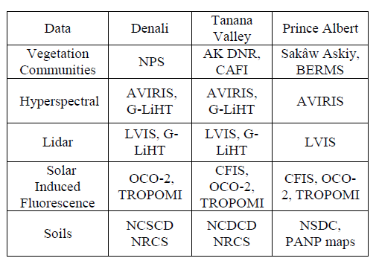
Remote Sensing Integration
1.) Integrate ABoVE Phase 1 hyperspectral and Lidar data with co-located G-LiHT LiDAR data to initialize forest structure and species comp of stands at each site.
(Co-PI Palace)
We will utilize these airborne data to test UVAFME output with a number of descriptor vertical profile metrics used previously in a study using canopy profiles from airborne LiDAR and Terrestrial Laser Scanner data. These metrics include a profile layer count, peak maxima, highest maxima, profile median height, and a ratio of median height to maximum height of each profile. At each case study site, we will conduct validation tests to examine UVAFME derived canopy metrics and compare them with ABOVE LiDAR product-derived metrics.
2.) Utilize SIF satellite data to calibrate and validate vegetation growth and productivity parameters of the UVAFME model (Co-I Yang)
We will utilize satellite SIF from the Orbiting Carbon Observatory 2 (OCO-2), the Tropospheric Monitoring Instrument (TROPOMI), and SIF-GPP relationships used in other studies to establish the relationship between SIF and GPP at our study sites, and then apply this relationship to airborne SIF observations from CFIS. This relationship will allow us to construct a photosynthetic rate map, derived from CFIS flights, at multiple times a day during the peak growing season from previous collections, which will be used to validate the simulation of GPP from UVAFME.

Slide 7
Forest Ecosystem Modeling
Remotely Sensed products calibrate and initialize UVAFME at 2 study sites.
UVAFME is integrated with the FACT forest ecosystem service model to construct estimates of forest ecosystem services (timber, carbon, and albedo) under climate and disturbance scenarios.
Model output is provided to stakeholder-based workshops and alternative management plans are elicited.
Simulations of alternative plans are analyzed from an ES perspective and provided to managers to assess efficacy of adaptation strategies.

Slide 8
Stakeholder Engagement
Site 1: Tanana Valley State Forest
Collaborators: Tanana Valley State Forest Citizen’s Advisory Committee, Alaska DNR, Division of Forestry
Site 2: Prince Albert National Park
Collaborators: Ministry of the Environment, Saskatchewan, Sakaw Askiy Management, Canadian Forest Service (still need to iron out details)
We will elicit judgements by each participant to form a matrix using relative scaling, adding fuzzy weights to capture overall confidence of each response. We will then elicit responses comparing the relationships between each management plan’s aforementioned characteristics with each of three hypothesized scenarios: a business as usual scenario, a resilience scenario, and a transformative scenario. We will then use the relative weights of the resultant vector of comparison matrices to calculate overall priorities for each scenario. These weights will be applied to the original management scenario harvest inputs so as to construct quantitative inputs for the hybridized UVAFME-FACT model.

